Slide 1

Department of Computer Science & Engineering
BIOMETRIC STEGANOGRAPHY USING MID POSITION VALUE TECHNIQUE
Date: 17 May 2021
BADAVATH KAVERI : 17WH1A0502
N UMA MAHESWARI : 17WH1A0527
V SATYA KRISHNA : 17WH1A0544
Internal Guide: Ms. C JAGADEESWARI
Designation: Assistant Professor
BVRIT HYDERABAD College of Engineering for Women

Slide 2
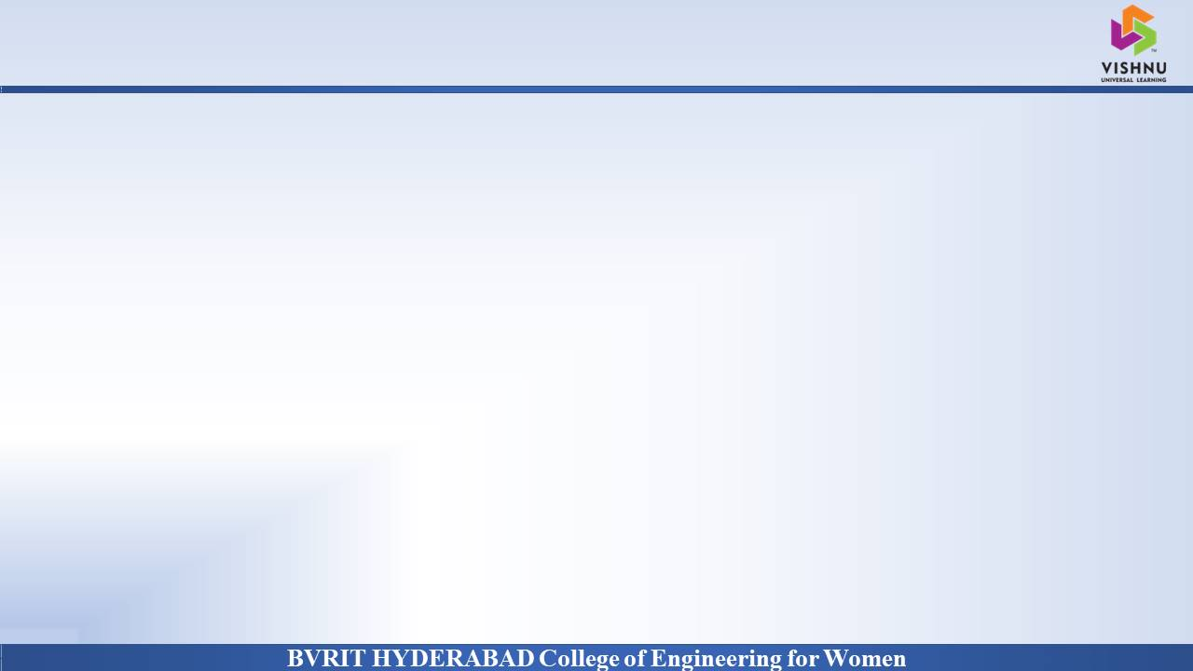
Why Should I Study this course?
ABSTRACT
Problem Statement:
The use of an individual’s biometric characteristics to advance authentication and verification technology beyond the current dependence on passwords has been the subject of extensive research for some time. Since such physical characteristics cannot be hidden from the public eye, the security of digitized biometric data becomes paramount to avoid the risk of substitution or replay attacks.
Project Objective:
To present a steganographic approach of concealing the secret data so as to facilitate secure communication. Arnold transformation will be imposed on the chosen secret image in the first stage. This results in the scrambling of the data bits, thereby disrupting the normal pixel orientation. Thereafter, data bits from the scrambled secret image are embedded within the cover. Henceforth the stego is generated.
Examples
BVRIT HYDERABAD College of Engineering for Women

Slide 3
Why Should I Study this course?
DATASET
Dataset Description:
Sokoto Coventry Fingerprint Dataset (SOCOFing) is a biometric fingerprint dataset designed for academic research purposes. It is made up of 6000 fingerprint images from 600 African subjects.
Examples
BVRIT HYDERABAD College of Engineering for Women

Slide 4
Why Should I Study this course?
ARCHITECTURE
Examples
Biometric image dataset gathering
Select the secret image
Apply Arnold Transformation
Display the stego image
Apply MPV technique
Choose the cover image from dataset
BVRIT HYDERABAD College of Engineering for Women

Slide 5
Why Should I Study this course?
TECHNOLOGY STACK
Language : Python
Tkinter
Python Packages:
NumPy
PIL
Tkinter
OpenCV
Matplotlib
Pandas
Examples
BVRIT HYDERABAD College of Engineering for Women

Slide 6

SYSTEM REQUIREMENTS
Environment | Specifications
Hardware | Processor - Intel Core i5 Memory(RAM) - 8 GB Storage – I TB
Software | Python OS - Windows 10 Google Colab Pycharm
Use this slide for flow of content.
BVRIT HYDERABAD College of Engineering for Women

Slide 7
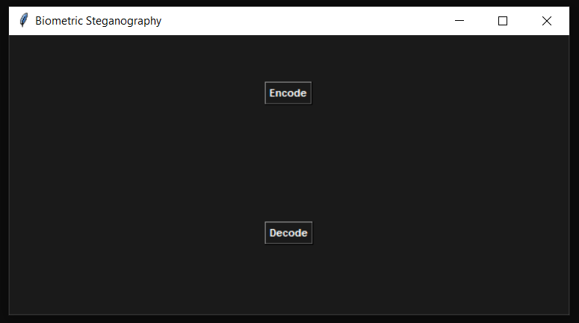
Why Should I Study this course?
IMPLEMENTATION
Examples
BVRIT HYDERABAD College of Engineering for Women

Slide 8
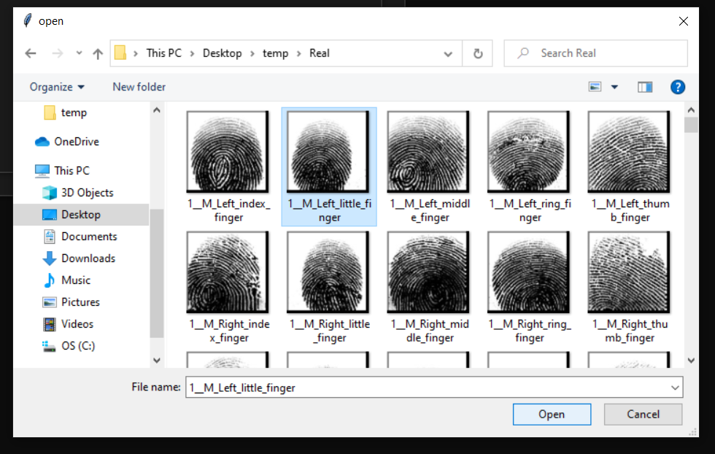
Why Should I Study this course?
IMPLEMENTATION
Examples
BVRIT HYDERABAD College of Engineering for Women

Slide 9
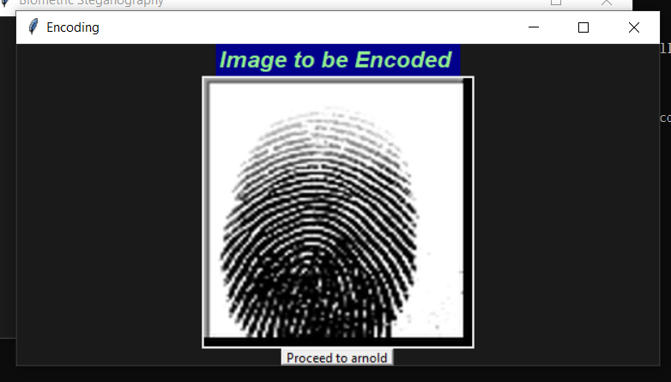
Why Should I Study this course?
IMPLEMENTATION
Examples
BVRIT HYDERABAD College of Engineering for Women

Slide 10
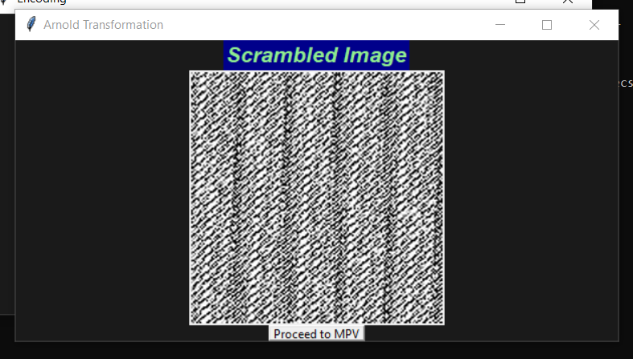
Why Should I Study this course?
IMPLEMENTATION
Examples
BVRIT HYDERABAD College of Engineering for Women

Slide 11
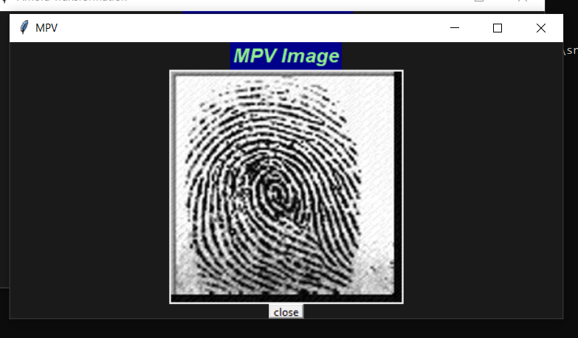
Why Should I Study this course?
IMPLEMENTATION
Examples
BVRIT HYDERABAD College of Engineering for Women

Slide 12
TIMELINE
Review 0 | Identifying the security need System specifications and requirements
Review 1 | Code Implementation
Review 2 | Applying Arnold transformation Inclusion of dataset
Review 3 | Generating UI using Tkinter Documentation

Slide 13
REFERENCES
[1]https://www.researchgate.net/publication/333559334_Integration_of_Biometrics_and_Steganography_A_Comprehensive_Review
[2]https://www.researchgate.net/publication/325657541_Image_Steganography_Using_Mid_Position_Value_Technique
[3]https://www.academia.edu/10228724/FINGERPRINT_BASED_IMAGE_STEGANOGRAPHY_IN_TRANSFORM_DOMAIN
[4]http://www.ijstr.org/final-print/dec2019/-Image-Steganography-Using-Lsb.pdf
BVRIT HYDERABAD College of Engineering for Women

Slide 14
Thankyou
BVRIT HYDERABAD College of Engineering for Women

